Slide 1
Google Play Store: App Permission Analytics
Prajit Kumar Das
Advised by: Dr. Anupam Joshi

Slide 2
Data collection stats
According to AppBrain
Current number of Android apps in the market: 1,596,584
54 App categories including Medical and Health & Fitness
46874 Health & Fitness Apps and 23824 Medical Apps
App data collected
Total app data collected: 1,431,736
42958 Health & Fitness Apps and 21033 Medical Apps
Does not reflect app permission info
Total number of apps whose permissions have been collected: 106,979
2620 Health & Fitness Apps and 758 Medical Apps

Slide 3
A bit more stats
Medical Apps request
262 unique permissions, top 20 requested permissions are shown below
Number of apps requesting permission | Permission Name
715 | android.permission.INTERNET
596 | android.permission.ACCESS_NETWORK_STATE
448 | android.permission.READ_EXTERNAL_STORAGE
447 | android.permission.WRITE_EXTERNAL_STORAGE
245 | android.permission.READ_PHONE_STATE
218 | android.permission.WAKE_LOCK
196 | android.permission.VIBRATE
151 | android.permission.GET_ACCOUNTS
145 | android.permission.ACCESS_FINE_LOCATION
143 | android.permission.ACCESS_COARSE_LOCATION
139 | com.google.android.c2dm.permission.RECEIVE
125 | android.permission.ACCESS_WIFI_STATE
91 | com.android.vending.BILLING
85 | android.permission.RECEIVE_BOOT_COMPLETED
80 | android.permission.CAMERA
67 | android.permission.CALL_PHONE
41 | android.permission.READ_CONTACTS
41 | com.google.android.providers.gsf.permission.READ_GSERVICES
41 | com.android.vending.CHECK_LICENSE
34 | android.permission.RECORD_AUDIO

Slide 4
A bit more stats
Health and Fitness Apps request
733 unique permissions, top 20 requested permissions are shown below
Number of apps requesting permission | Permission Name
2501 | android.permission.INTERNET
2204 | android.permission.ACCESS_NETWORK_STATE
1413 | android.permission.WRITE_EXTERNAL_STORAGE
1404 | android.permission.READ_EXTERNAL_STORAGE
816 | android.permission.WAKE_LOCK
715 | android.permission.READ_PHONE_STATE
618 | android.permission.VIBRATE
577 | android.permission.ACCESS_WIFI_STATE
575 | android.permission.ACCESS_FINE_LOCATION
516 | android.permission.ACCESS_COARSE_LOCATION
498 | android.permission.GET_ACCOUNTS
445 | com.google.android.c2dm.permission.RECEIVE
362 | android.permission.RECEIVE_BOOT_COMPLETED
322 | com.android.vending.BILLING
285 | android.permission.CAMERA
173 | android.permission.RECORD_AUDIO
150 | com.android.vending.CHECK_LICENSE
140 | android.permission.GET_TASKS
139 | com.google.android.providers.gsf.permission.READ_GSERVICES
122 | android.permission.SYSTEM_ALERT_WINDOW

Slide 5
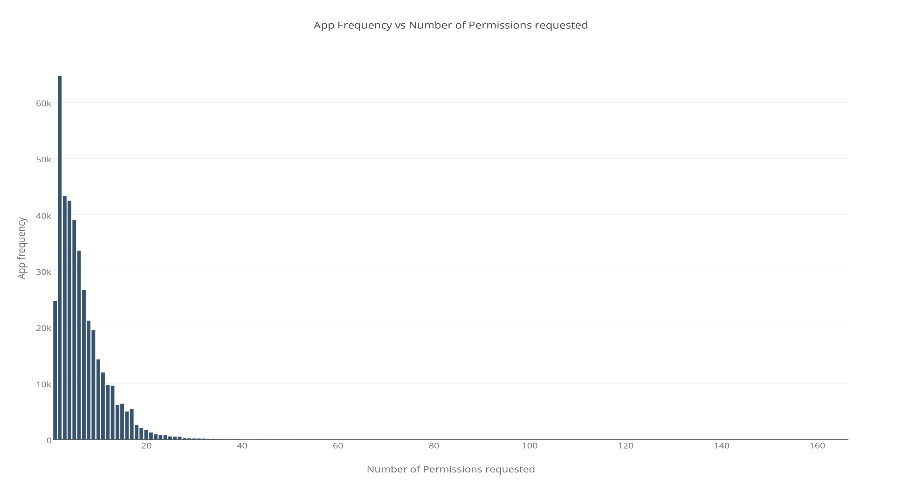
App frequency vs Permissions requested
App Package Name | Permissions Count
com.google.android.gms | 102
com.grabtaxi.system | 84
com.customermobile.att.samsung.gs4 | 83
com.tencent.mtt | 82
com.qihoo360.mobilesafe | 81
com.comfinix.android.barotalk | 81
com.nineninetaxis.driver | 77
com.google.android.googlequicksearchbox | 75
com.airwatch.androidagent | 71
com.qihoo360.launcher | 69
com.vodafone.androidagent | 69
App Count | Permission Name
100863 | android.permission.INTERNET
90819 | android.permission.ACCESS_NETWORK_STATE
64766 | android.permission.READ_EXTERNAL_STORAGE
64703 | android.permission.WRITE_EXTERNAL_STORAGE
39355 | android.permission.READ_PHONE_STATE
34173 | android.permission.ACCESS_WIFI_STATE
33256 | android.permission.WAKE_LOCK
24500 | android.permission.VIBRATE
17503 | android.permission.ACCESS_COARSE_LOCATION
17030 | android.permission.ACCESS_FINE_LOCATION
17003 | android.permission.GET_ACCOUNTS

Slide 6
Algorithm working on
Transform an app to a vector rep by denoting which permission it is requesting
Technique 1: Use vector as an input to k-means clustering – Does app category become evident?
Technique 2: Select a category and using app permission vector try to detect outlier apps
Technique 3:
For apps requesting a bunch of unique permissions, extract app description
Can semantic similarity help in matching descriptions to permissions

Slide 7
Cluster evaluation
K-Means cluster evaluation measures:
Homogeneity Score: A clustering result satisfies homogeneity if all of its clusters contain only data points which are members of a single class.
Completeness Score: A clustering result satisfies completeness if all the data points that are members of a given class are elements of the same cluster.
Working on other measures and K-Medoid

Slide 8
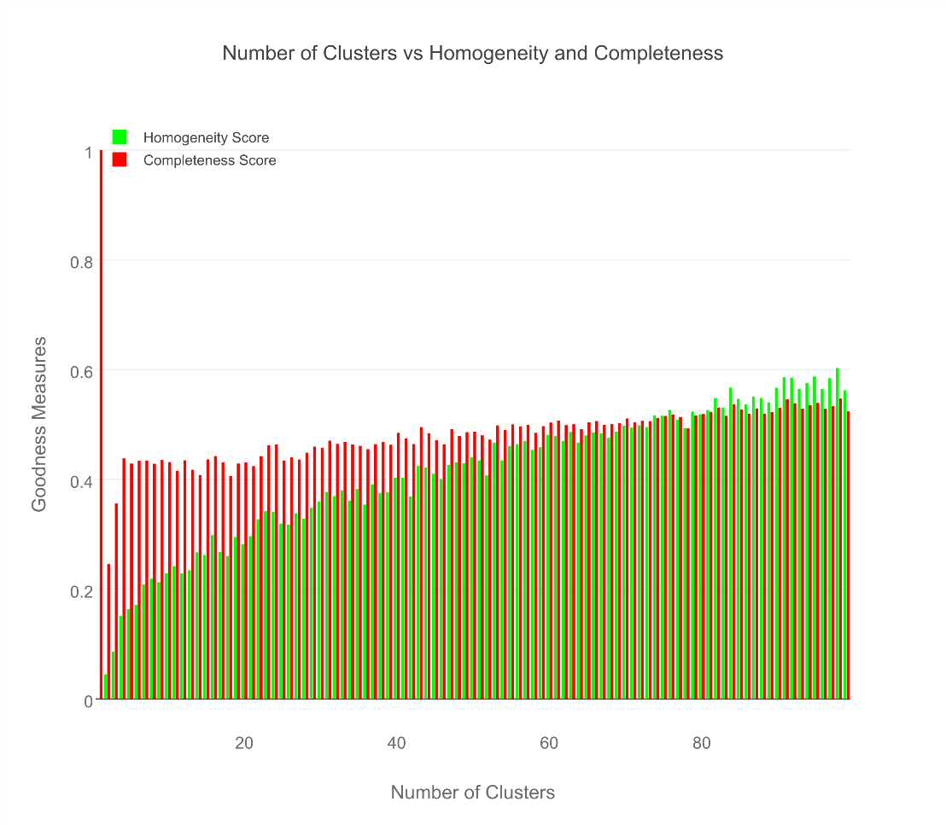
Cluster evaluation

Slide 9
Results for Medical & Healthcare Apps
AppPkgName | Cluster Assignment | AppCategory
com.fitnow.loseit | 13 | Health & Fitness
com.webmd.android | 13 | Health & Fitness
com.drugscom.app | 13 | Medical
com.ovuline.pregnancy | 13 | Medical
air.com.peppapig.paintbox | 13 | Educational
com.t11.skyviewfree | 13 | Education
gov.nasa | 13 | Education
com.google.android.stardroid | 13 | Books & Reference
com.turner.cnvideoapp | 13 | Media & Video
com.nextradioapp.nextradio | 13 | Music & Audio
com.camerasideas.instashot | 13 | Photography
com.foxsports.videogo | 13 | Sports
com.theopen | 13 | Sports
com.tregware.radar | 13 | Weather

Slide 10
Results for All Medical Apps
AppPkgName | Cluster Assignment | AppCategory
com.drugscom.app | 13 | Medical
com.ovuline.pregnancy | 13 | Medical
com.jardogs.fmhmobile | 14 | Medical
com.goodrx | 49 | Medical
com.microphone.earspy | 65 | Medical
com.hp.pregnancy.lite | 75 | Medical
com.carezone.caredroid.careapp.medications | 80 | Medical
com.smsrobot.period | 94 | Medical
epic.mychart.android | 96 | Medical

Slide 11
Results for All Health & Fitness Apps
AppPkgName | Cluster Assignment | AppCategory
com.fitnow.loseit | 13 | Health & Fitness
com.webmd.android | 13 | Health & Fitness
com.period.tracker.lite | 27 | Health & Fitness
com.popularapp.periodcalendar | 27 | Health & Fitness
com.cvs.launchers.cvs | 32 | Health & Fitness
com.babycenter.pregnancytracker | 54 | Health & Fitness
com.fitbit.FitbitMobile | 60 | Health & Fitness
com.myfitnesspal.android | 87 | Health & Fitness
com.google.android.apps.fitness | 91 | Health & Fitness
com.tayu.tau.pedometer | 94 | Health & Fitness

Slide 12
Library Apps seem like the best
AppPkgName | Cluster Assignment | AppCategory
com.aviary.android.feather.plugins.borders.free | 5 | Libraries & Demo
com.aviary.android.feather.plugins.filters.original | 5 | Libraries & Demo
com.aviary.android.feather.plugins.stickers.free_stickers | 5 | Libraries & Demo
com.estrongs.chromecast | 5 | Libraries & Demo
com.foxfi.addon | 5 | Libraries & Demo
com.mxtech.ffmpeg.v7_neon | 5 | Libraries & Demo
com.mxtech.ffmpeg.v7_vfpv3d16 | 5 | Libraries & Demo
com.google.samples.apps.cardboarddemo | 27 | Libraries & Demo
com.google.vr.cardboard.apps.designlab | 27 | Libraries & Demo
com.ivona.tts | 65 | Libraries & Demo

Slide 13
Finance apps seem to pretty uniform
AppPkgName | Cluster Assignment | AppCategory
com.google.android.apps.walletnfcrel | 31 | Finance
com.infonow.bofa | 31 | Finance
com.paypal.android.p2pmobile | 31 | Finance
com.geico.mobile | 32 | Finance
com.creditkarma.mobile | 57 | Finance
com.acorns.android | 58 | Finance
com.chase.sig.android | 58 | Finance
com.venmo | 58 | Finance
com.wf.wellsfargomobile | 58 | Finance

Slide 14
What did we see in cluster 5?
read phone status and identity, full network access
read sensitive log data, full network access
find accounts on the device, control vibration, run at startup, read Google service configuration, full network access
modify or delete the contents of your USB storage, read the contents of your USB storage, Wi-Fi connection information, view Wi-Fi connections, Google Play license check, full network access, prevent device from sleeping, view network connections
precise location (GPS and network-based), draw over other apps

Slide 15
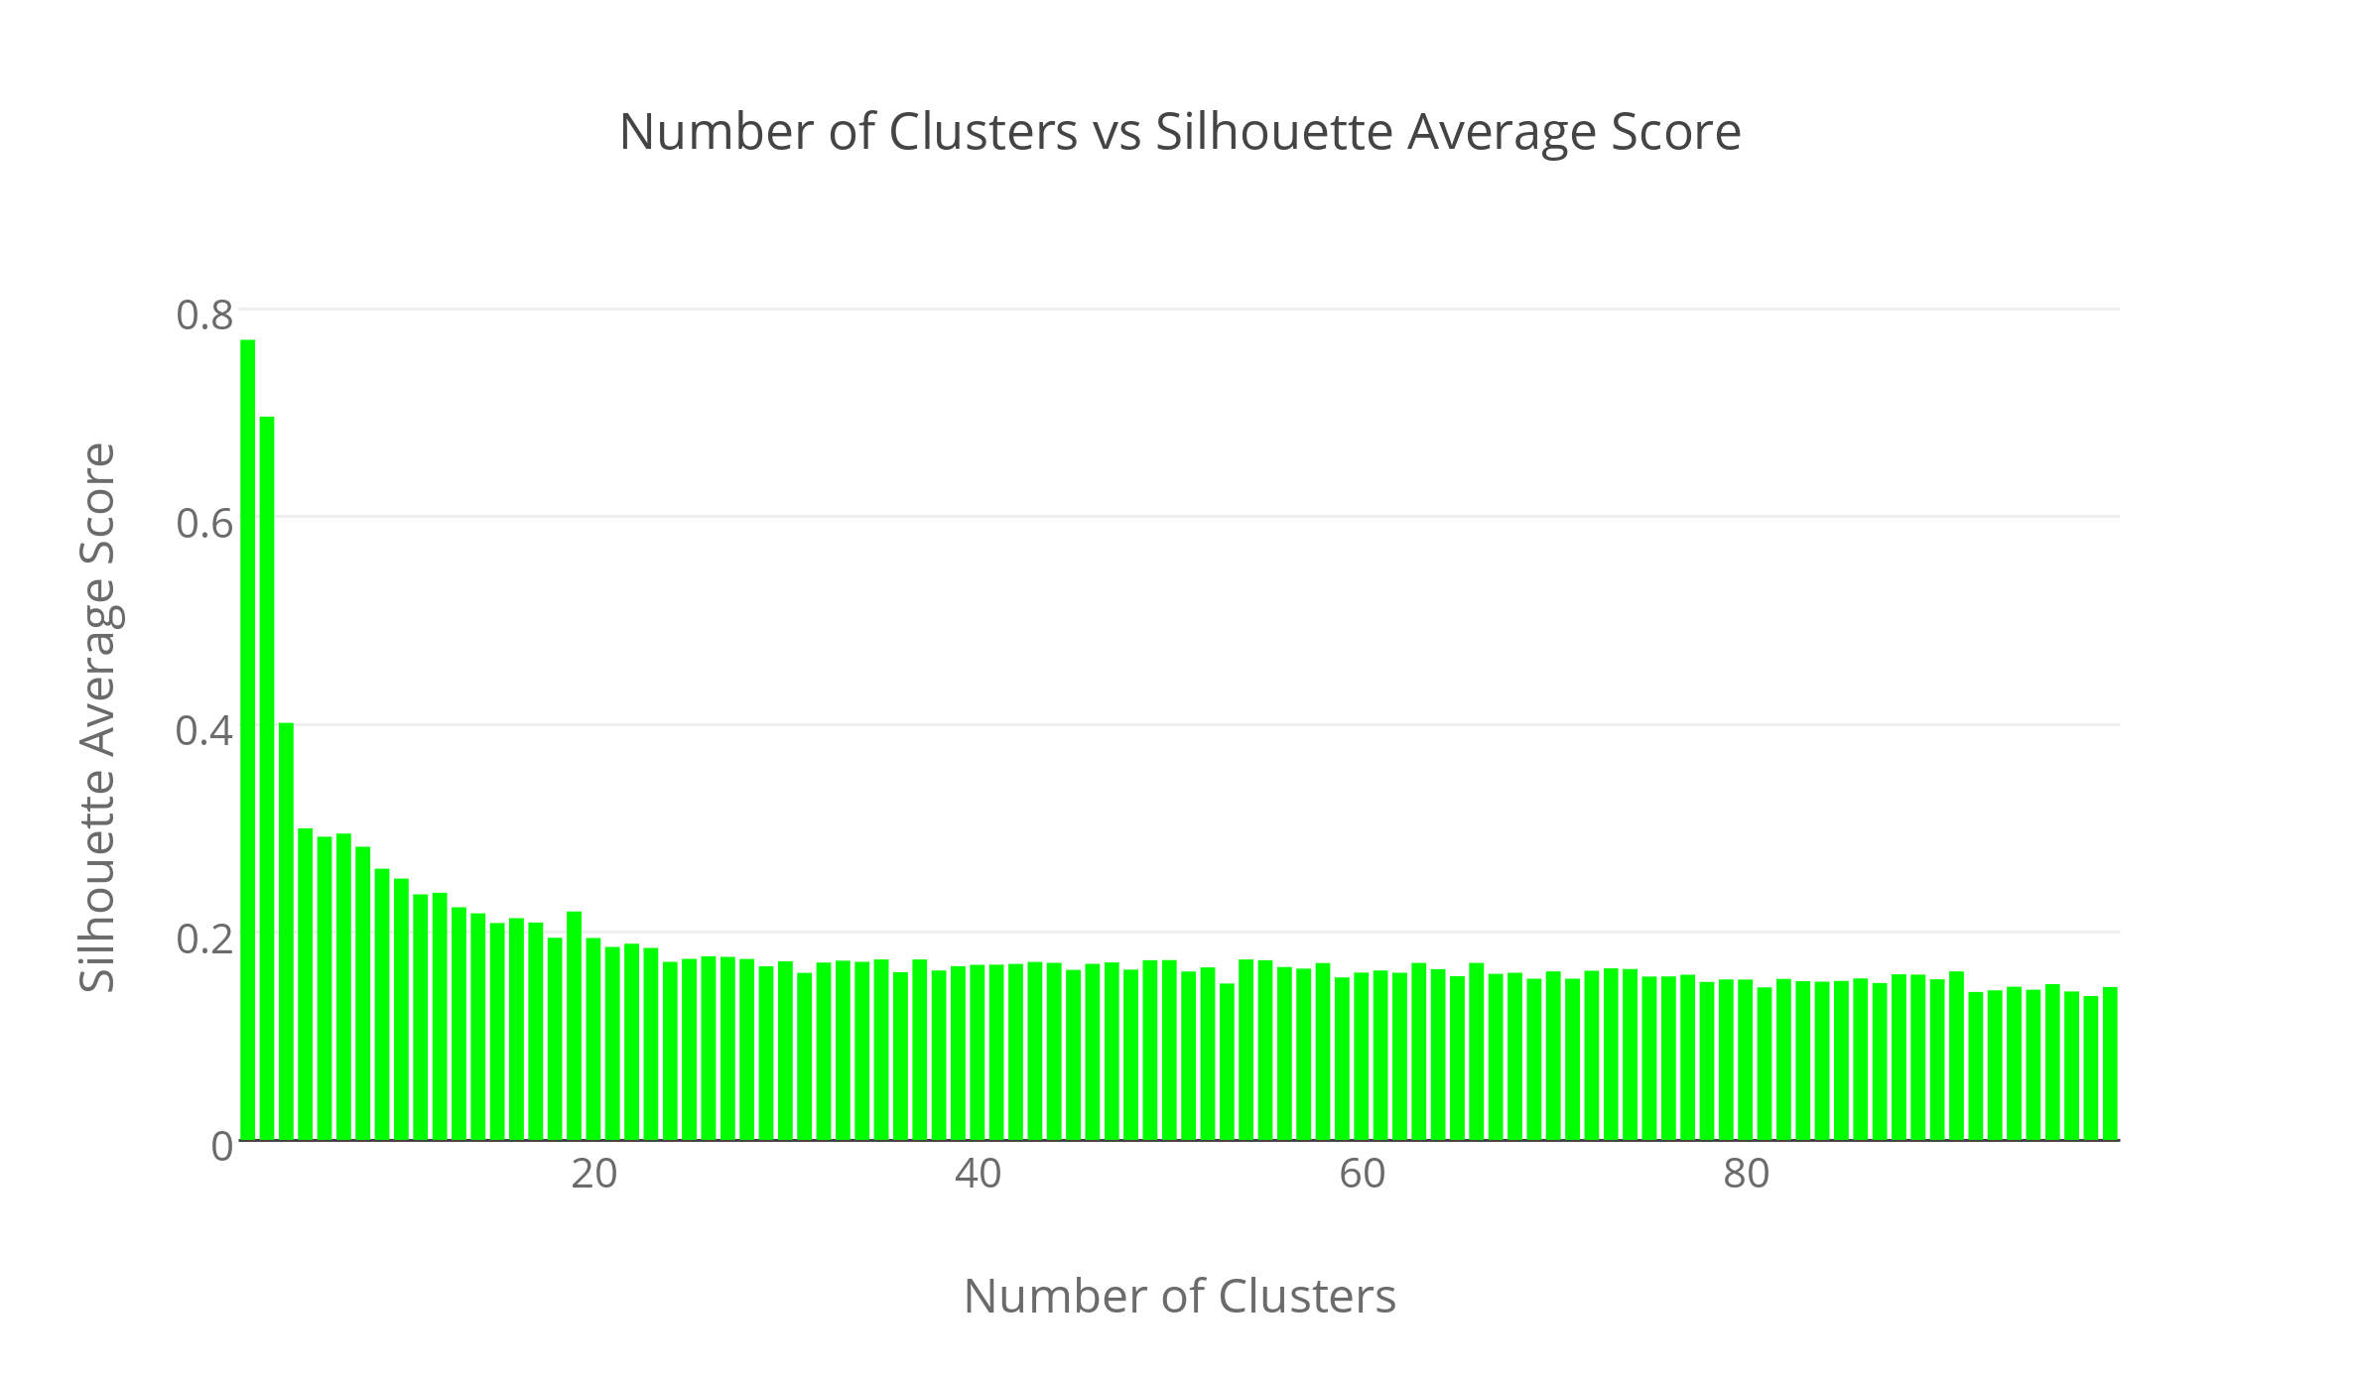
Clustering is not the right way…

Slide 16
Manhattan distance

